Slide 1
J-K Flip-Flop
Joshua Gould
12/5/2018
ECE 09.414 VLSI Design
Dept. of ECE
Henry M. Rowan College of Engineering
Rowan University

Slide 2
Outline
J-K Flip-Flop Overview / Description
Features / Problems
Block Diagram
Truth Table
Master Slave Design
Design Choices
Logical Design
Worst Case Design
Logical Effort, Number of Stages, Delay
Gate Sizes for Optimized Design
Standard Cell Library & Layout Simulations
Conclusion

Slide 3
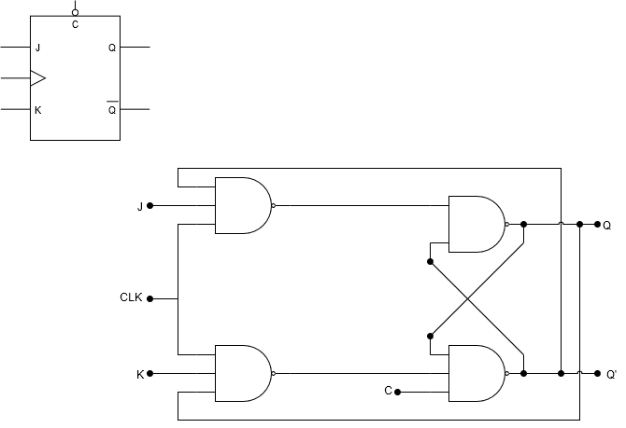
Block Diagram

Slide 4

Truth Table
Inputs |  |  |  | Outputs |  | Action
J | K | CLK | CLR | Q | Q’
0 | 0 | Edge | 0 | Last Q | Last Q’ | Retain State
0 | 1 | Edge | 0 | 0 | 1 | Reset Q
1 | 0 | Edge | 0 | 1 | 0 | Set Q
1 | 1 | Edge | 0 | Last QN | Last Q | Toggle
0 or 1 | 0 or 1 | 0 or 1 | 1 | 0 | 1 | Asynchronously Reset Q
0 or 1 | 0 or 1 | 0 or 1 | 1 | Last Q | Last QN | Illegal State
$$Q_{next} = J\overline{\overline{Q}}+\overline{\overline{K}}Q$$

Slide 5
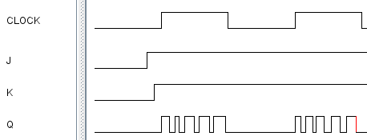
JK Flip-Flop Issues
Uncontrolled toggling when clock is high
Minimized features

Slide 6
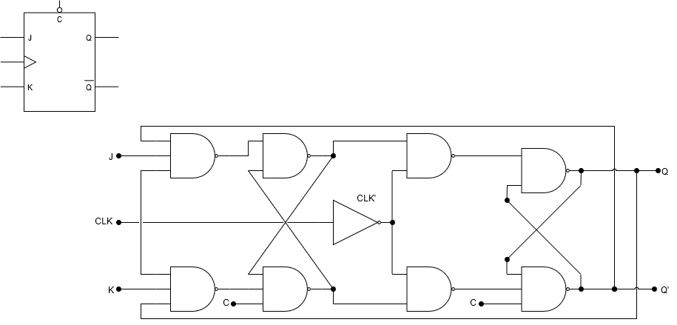
Master/Slave Flip-Flop
Master Latch
Slave Latch
Two latch stages in a cascaded configuration
Activated with opposite clock phases
Eliminates uncontrolled oscillations since only one stage is active at any given time

Slide 7
Master/Slave Flip-Flop
Master Latch
Slave Latch
Single flip-flops suffer from “race” timing problems
Race timing occurs if the output Q changes state before the timing pulse of the clock input has time to go “OFF”.

Slide 8
Design Overview
POSSIBILITY 1: NAND Logic Gate
  PROS:
    Simple design
    Smallest design area
    Uses simple gates
  CONS:
    Notable output timing errors
    Minimized features
    Limited in pulse width for the clock and inputs

Slide 9
Design Overview
POSSIBILITY 2: Master-Slave NAND Logic Gate
  PROS:
    Simple design doubled
    Fixes race error
  CONS:
    Uneven design with clear
    Large amount of transistors
    Minimized features (no PRESET)
    Some constraints on the clock pulse width
    Delay on Slave latch (1/2 clock period)

Slide 10
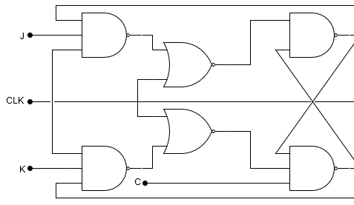
Design Overview
POSSIBILITY 3: NOR based JK Flip-Flop
  PROS:
    Fixes the SR Latch with the 3
    input NANDs so all inputs are
    allowed.
  CONS:
    Inputs must be stable for
    some time before clock goes low.
    The output will oscillate continuously until the or one of the input signals goes low
    Larger design area than NAND only (+2 NOR +2 NOT)
    Highest number of transistors required

Slide 11
Design Overview
POSSIBILITY 2: Master-Slave NAND Logic Gate
    Fixes race error
    Faster than NOR design

Slide 12
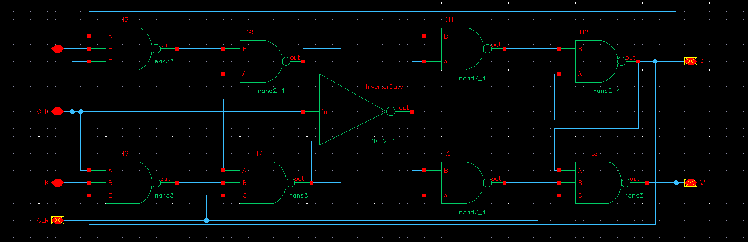
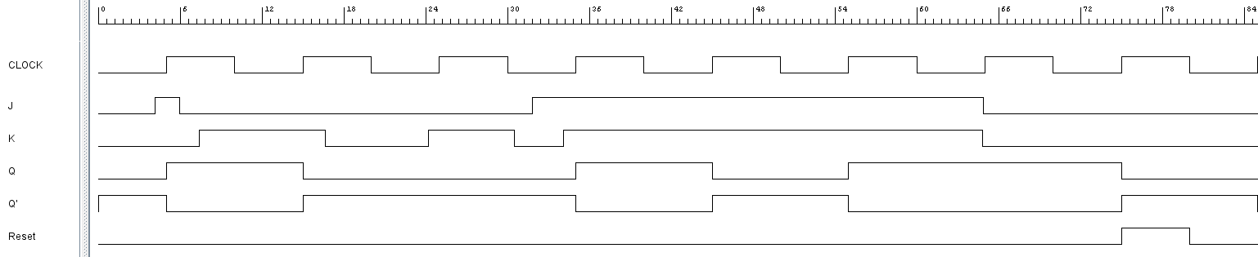
Logic Design

Slide 13
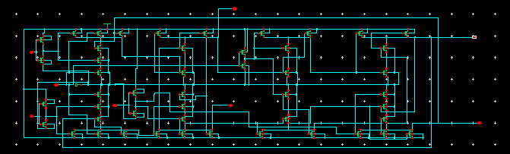
Transistor Design

Slide 14
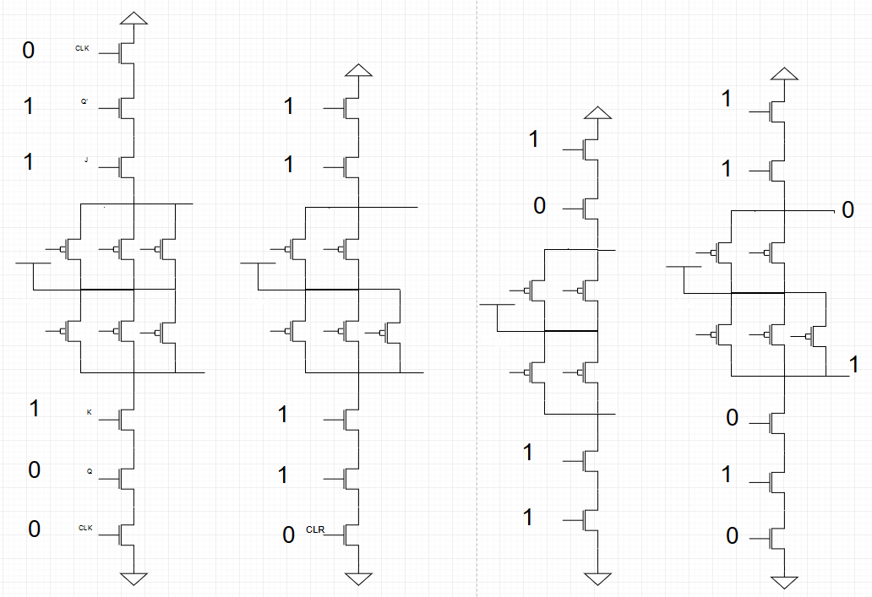
Worst Case Logical Path
J
Q’
CLK
CLK
Q
K

Slide 15
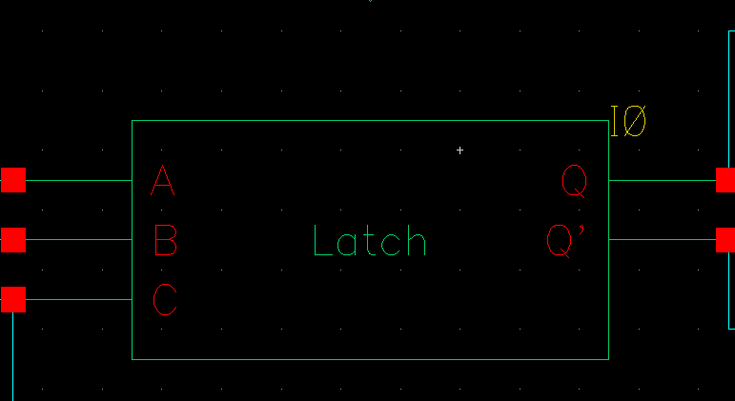
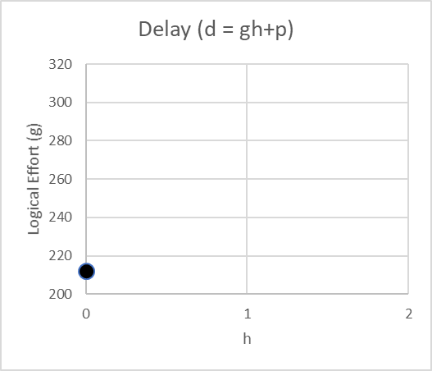
Latch Delay Calculation
The logical effort of the flip-flop must be characterized in Cadence due to the feedback path on each latch.
Use d = gh + p to find latch parameters

Slide 16
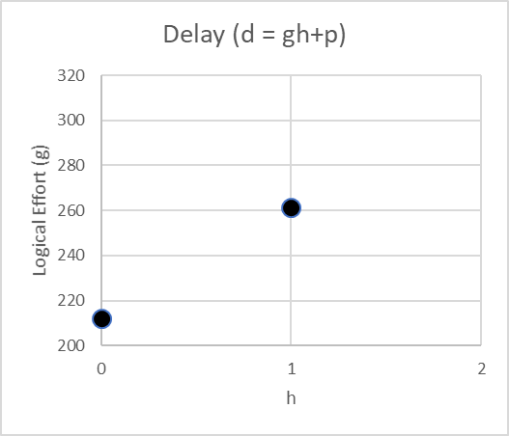
Latch Delay Calculation
The logical effort of the flip-flop must be characterized in Cadence due to the feedback path on each latch.
Use d = gh + p to find latch parameters

Slide 17
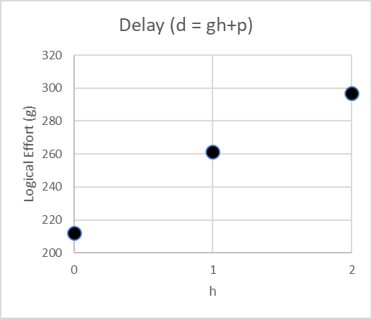
Latch Delay Calculation
The logical effort of the flip-flop must be characterized in Cadence due to the feedback path on each latch.
Use d = gh + p to find latch parameters

Slide 18
Latch Delay Calculation
h | g
0 | 212.105
1 | 261.3
2 | 297.012
d = gh+p
= 42.45h + 214.35
g = 42.45
p = 212.105

Slide 19
Effective Latch Stages & Normalization
Due to its dependence on feedback path, the latch may not be best described by a single stage.
The parasitic delay of the latch was divided by that of a similar-sized inverter.
We'll assign 2 stages to the latch.

Slide 20
Inverter Delay Calculation
h | g
0 | 49.9
1 | 73.2
2 | 109
d = gh+p
= 29.55h + 49.9
g = 29.55
p = 49.9
Normalized Average
g = 1
p = 1

Slide 21
Latch Delay Calculation
h | g
0 | 212.105
1 | 261.3
2 | 297.012
d = gh+p
= 42.45h + 214.35
g = 42.45
p = 212.105
Normalized Average
g = 1.4367
p = 4.2506

Slide 22
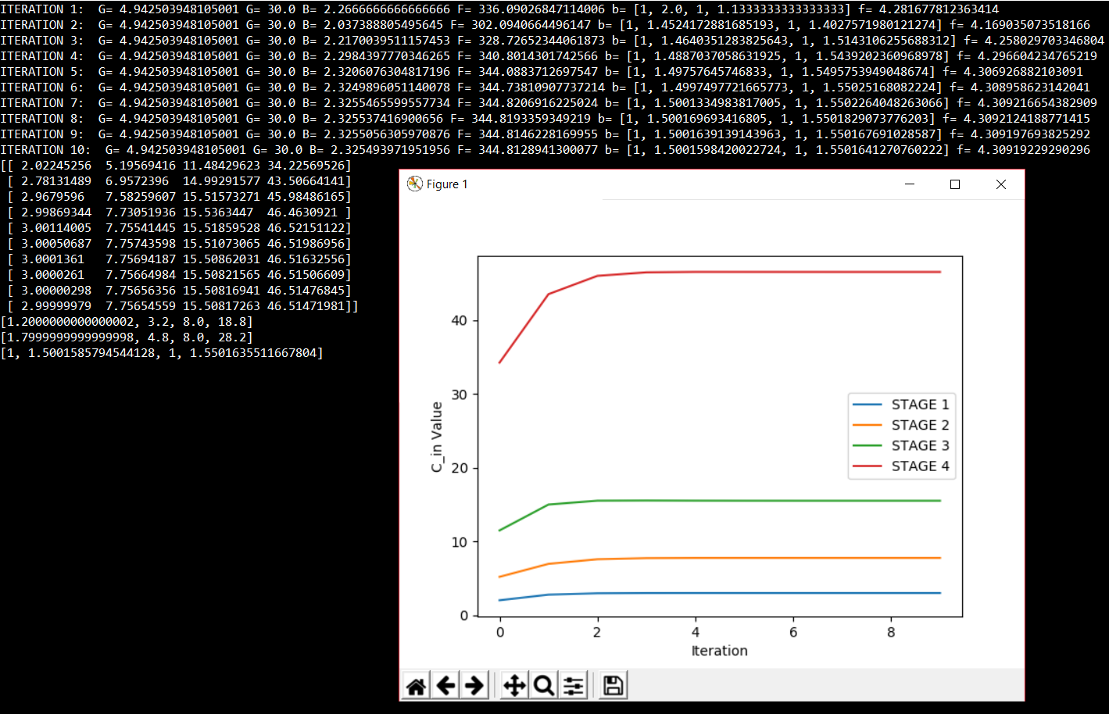
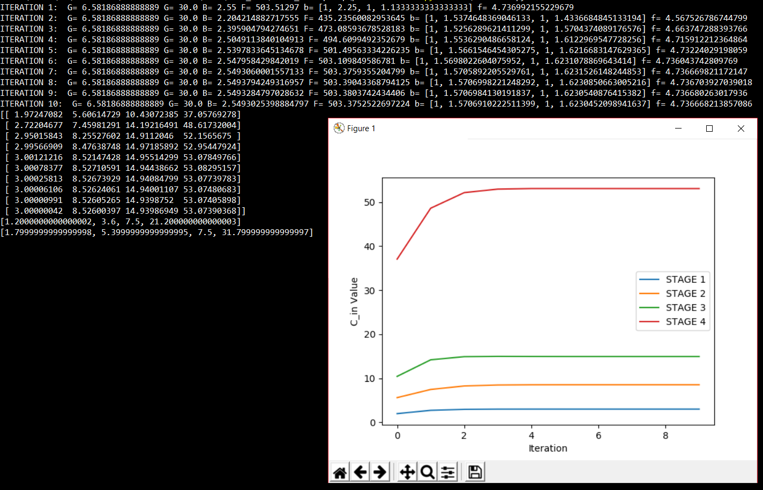
Gate Sizes for Optimized Design
Top Logic
Bottom Logic

Slide 23
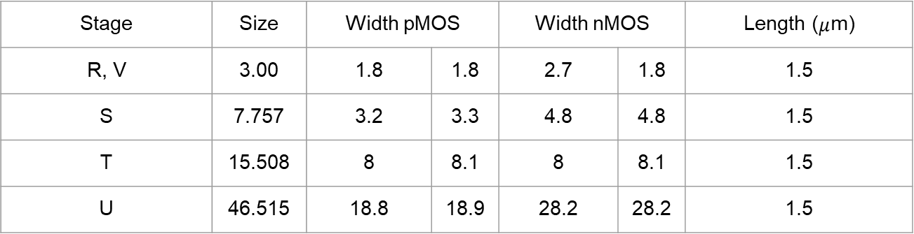
Gate Sizes for Optimized Design
R
S
T
U
V
W
X
Y
Stage | Size | Width pMOS |  | Width nMOS |  | Length ($μ$m)
R, V | 3.00 | 1.8 | 1.8 | 2.7 | 1.8 | 1.5
S | 7.757 | 3.2 | 3.3 | 4.8 | 4.8 | 1.5
T | 15.508 | 8 | 8.1 | 8 | 8.1 | 1.5
U | 46.515 | 18.8 | 18.9 | 28.2 | 28.2 | 1.5

Slide 24

Gate Sizes for Optimized Design
R
S
T
U
V
W
X
Y
Stage | Size | Width pMOS |  | Width nMOS |  | Length ($μ$m)
R,V | 3.00 | 1.8 | 1.8 | 2.7 | 1.8 | 1.5
W | 8.52 | 3.6 | 3.6 | 5.4 | 5.4 | 1.5
X | 14.940 | 7.5 | 7.5 | 7.5 | 7.5 | 1.5
Y | 53.074 | 21.2 | 21.3 | 31.8 | 31.8 | 1.5

Slide 25
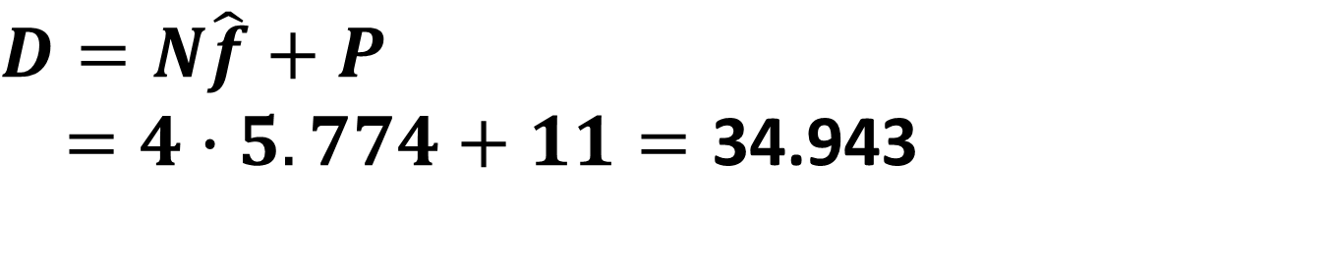
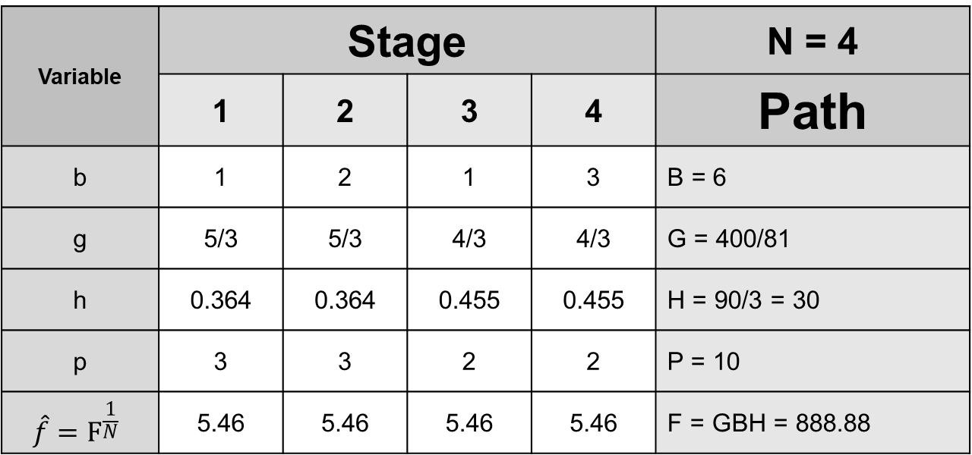
Logical Effort, Number of Stages, Delay
Variable | Stage |  |  |  | N = 4
 | 1 | 2 | 3 | 4 | Path
b | 1 | 2 | 1 | 3 | B = 6
g | 5/3 | 1.4367 | 4/3 | 1.4367 | G = 4.5869042
h | 3.276 | 3.8004 | 4.095 | 3.8004 | H = 90/3 = 30
p | 3 | 4.2506 | 2 | 4.2506 | P = 13.5012
 | 5.46 | 5.46 | 5.46 | 5.46 | F = GBH = 825.64276
$$D=N\hat{f}+P$$
$=4∙5.774+11=\text{34.94}\text{3}$

Slide 26
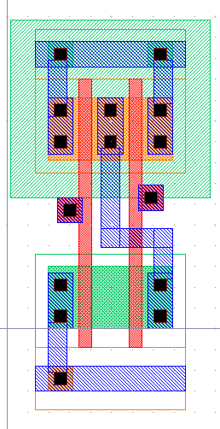
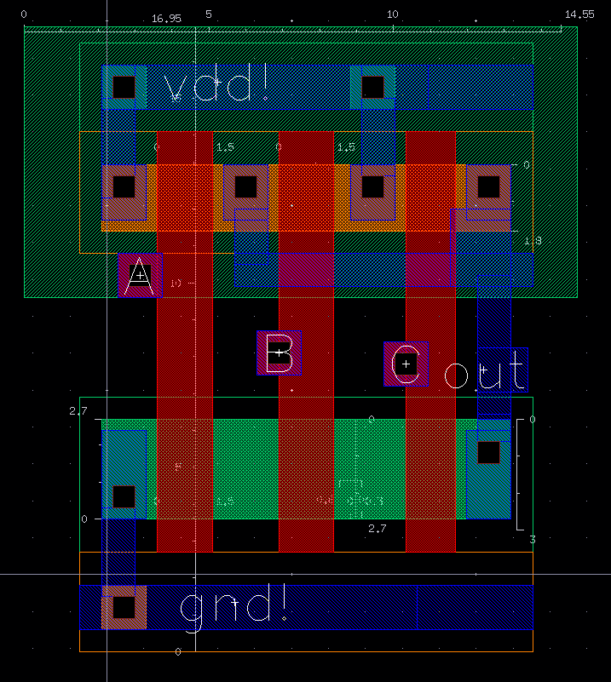
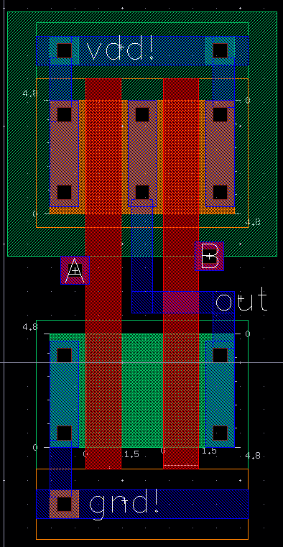
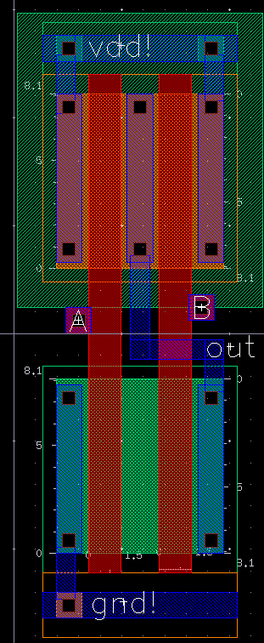
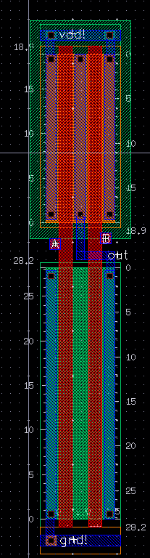
Standard Cell Library
R
S
T
U
U
V
W
X
Y
R
S
T
U

Slide 27
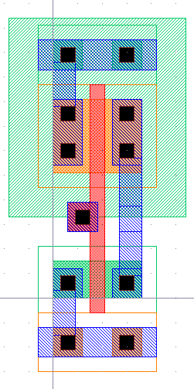
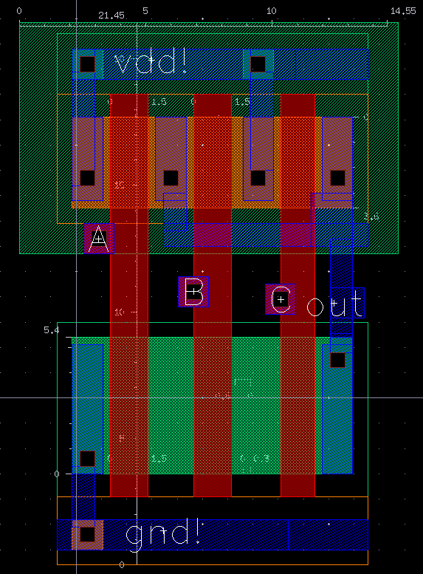
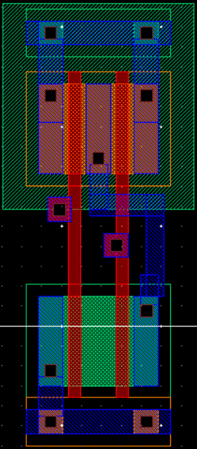
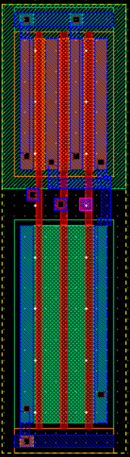
Standard Cell Library
R
S
T
U
U
V
W
X
Y
V
W
X
Y

Slide 28
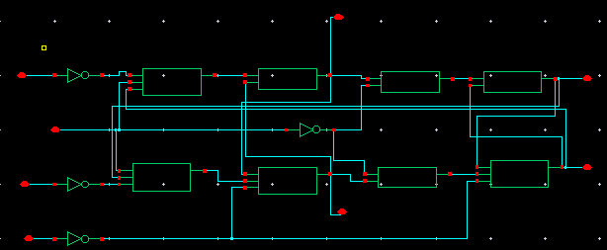
Pre-Layout Simulations

Slide 29
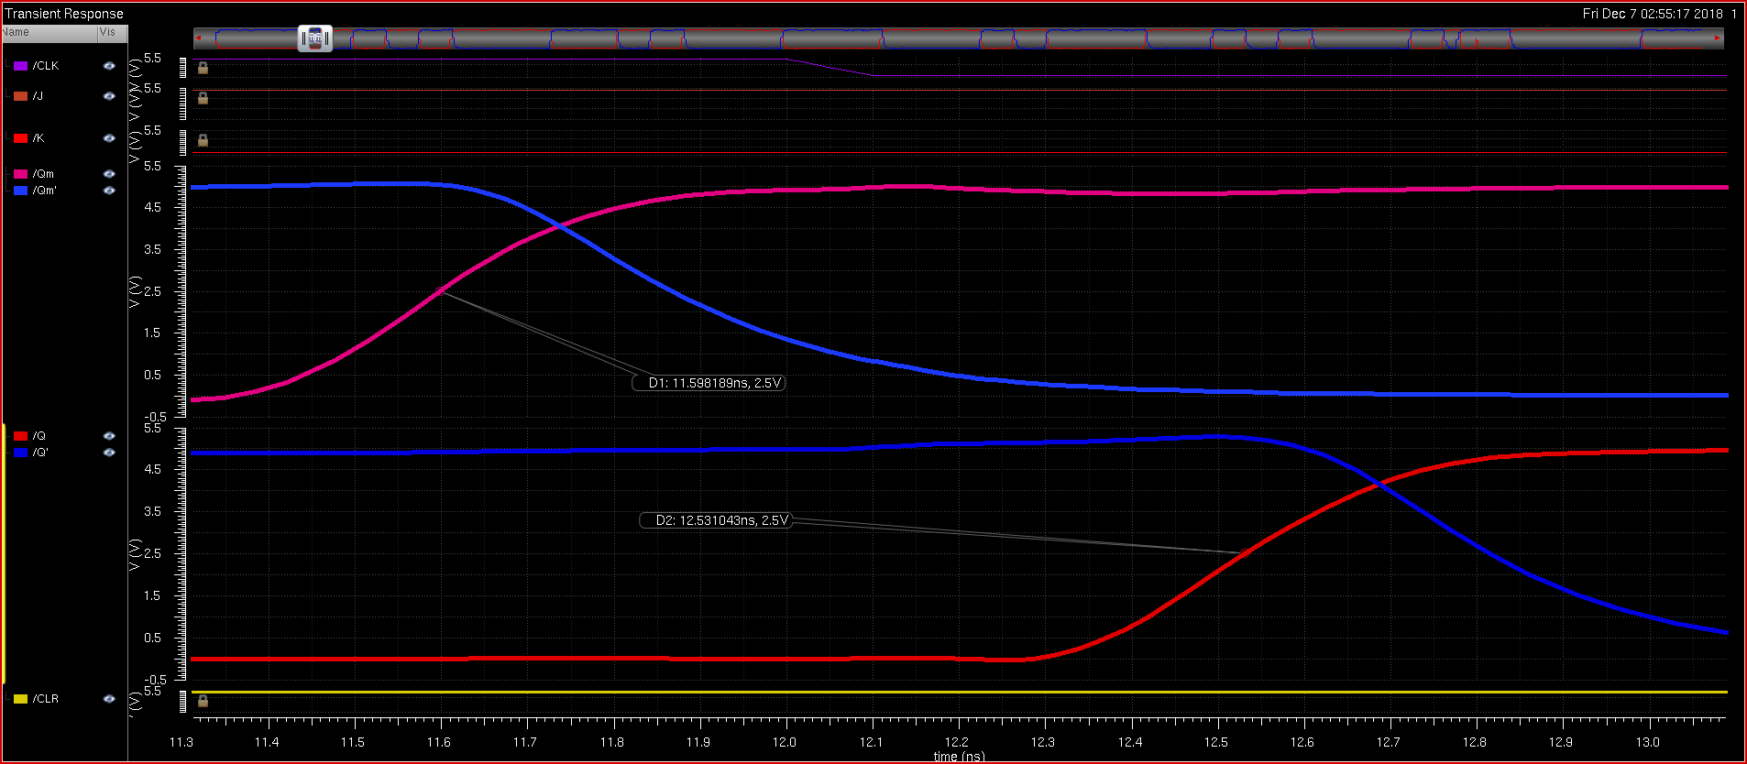
Pre-Layout Simulations
Master and Slave have a delay between each other of half a clock cycle, understandably slowing down output

Slide 30
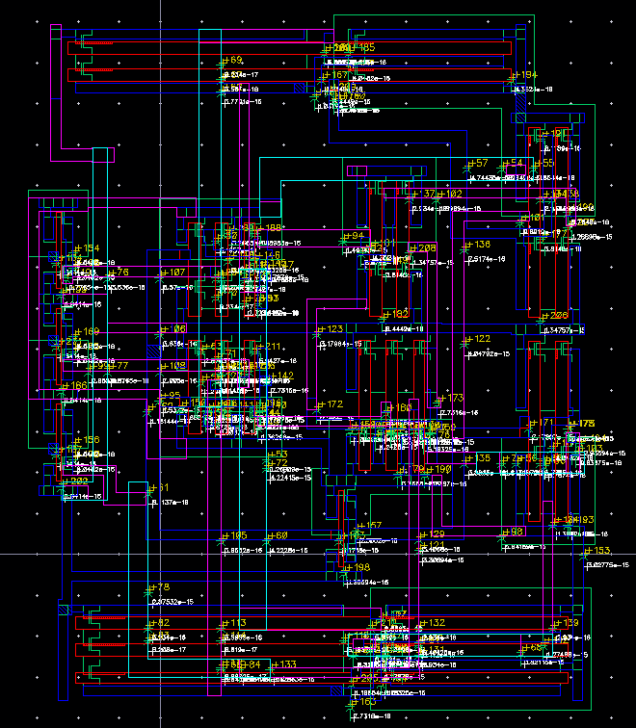
Standard Cell Library Extracted Layouts

Slide 31
Standard Cell Library Simulation
“Spectre” Netlist
t 5 J inputOutput
t 29 K inputOutput
t 28 Q inputOutput
t 14 Q' inputOutput
t 3 CLK inputOutput
t 27 CLR inputOutput
t 22 Qm inputOutput
t 30 Qm' inputOutput
n 1 vdd!
n 0 gnd!
n 2 /net48
n 3 /CLK
n 4 /net014
n 5 /J
n 6 /net53
n 7 /net12
n 8 /net55
n 9 /net013
n 10 /net025
n 11 /net51
n 12 /net0115
n 13 /net58
n 14 /Q'
n 15 /net49
n 16 /net058
n 17 /net9
n 18 /net57
n 19 /net54
n 20 /net56
n 21 /net50
n 22 /Qm
n 23 /net057
n 24 /net030
n 27 /CLR
n 28 /Q
n 29 /K
n 30 /Qm'
; nmos4 Instance /N41 = auLvs device Q0
d nmos D G S B (p D S)
i 0 nmos 12 27 0 0 " m 1 l 600e-9 w 1.5e-6 "
; nmos4 Instance /N40 = auLvs device Q1
i 1 nmos 4 29 0 0 " m 1 l 600e-9 w 1.5e-6 "
; nmos4 Instance /N39 = auLvs device Q2
i 2 nmos 9 5 0 0 " m 1 l 600e-9 w 1.5e-6 "
; nmos4 Instance /N36 = auLvs device Q3
i 3 nmos 10 3 0 0 " m 1 l 600e-9 w 1.5e-6 "
; nmos4 Instance /N32 = auLvs device Q4
i 4 nmos 23 22 0 0 " m 1 l 600e-9 w 3e-6 "
; nmos4 Instance /N25 = auLvs device Q5
i 5 nmos 22 30 11 0 " m 1 l 600e-9 w 3e-6 "
; nmos4 Instance /N26 = auLvs device Q6
i 6 nmos 15 28 21 0 " m 1 l 600e-9 w 3e-6 "
; nmos4 Instance /N21 = auLvs device Q7
i 7 nmos 19 12 30 0 " m 1 l 600e-9 w 5.7e-6 "
; nmos4 Instance /N55 = auLvs device Q8
i 8 nmos 0 22 6 0 " m 1 l 600e-9 w 5.7e-6 "
; nmos4 Instance /N34 = auLvs device Q9
i 9 nmos 16 30 0 0 " m 1 l 600e-9 w 3e-6 "
; nmos4 Instance /N33 = auLvs device Q10
i 10 nmos 0 10 16 0 " m 1 l 600e-9 w 3e-6 "
; nmos4 Instance /N53 = auLvs device Q11
i 11 nmos 7 14 8 0 " m 1 l 600e-9 w 2.7e-6 "
; nmos4 Instance /N51 = auLvs device Q12
i 12 nmos 20 3 0 0 " m 1 l 600e-9 w 2.7e-6 "
; nmos4 Instance /N30 = auLvs device Q13
i 13 nmos 21 0 14 0 " m 1 l 600e-9 w 3e-6 "
; nmos4 Instance /N28 = auLvs device Q14
i 14 nmos 0 12 15 0 " m 1 l 600e-9 w 3e-6 "
; nmos4 Instance /N29 = auLvs device Q15
i 15 nmos 2 24 0 0 " m 1 l 600e-9 w 3e-6 "
; nmos4 Instance /N50 = auLvs device Q16
i 16 nmos 0 3 13 0 " m 1 l 600e-9 w 2.7e-6 "
; nmos4 Instance /N27 = auLvs device Q17
i 17 nmos 28 14 2 0 " m 1 l 600e-9 w 3e-6 "
; nmos4 Instance /N22 = auLvs device Q18
i 18 nmos 11 7 0 0 " m 1 l 600e-9 w 3e-6 "
; nmos4 Instance /N54 = auLvs device Q19
i 19 nmos 6 17 19 0 " m 1 l 600e-9 w 5.7e-6 "
; nmos4 Instance /N52 = auLvs device Q20
i 20 nmos 8 9 20 0 " m 1 l 600e-9 w 2.7e-6 "
; nmos4 Instance /N49 = auLvs device Q21
i 21 nmos 13 4 18 0 " m 1 l 600e-9 w 2.7e-6 "
; nmos4 Instance /N31 = auLvs device Q22
i 22 nmos 24 10 23 0 " m 1 l 600e-9 w 3e-6 "
; nmos4 Instance /N48 = auLvs device Q23
i 23 nmos 18 28 17 0 " m 1 l 600e-9 w 2.7e-6 "
; pmos4 Instance /P33 = auLvs device Q24
d pmos D G S B (p D S)
i 24 pmos 12 27 1 1 " m 1 l 600e-9 w 3e-6 "
; pmos4 Instance /P32 = auLvs device Q25
i 25 pmos 4 29 1 1 " m 1 l 600e-9 w 3e-6 "
; pmos4 Instance /P31 = auLvs device Q26
i 26 pmos 9 5 1 1 " m 1 l 600e-9 w 3e-6 "
; pmos4 Instance /P27 = auLvs device Q27
i 27 pmos 24 10 1 1 " m 1 l 600e-9 w 3e-6 "
; pmos4 Instance /P26 = auLvs device Q28
i 28 pmos 24 22 1 1 " m 1 l 600e-9 w 3e-6 "
; pmos4 Instance /P25 = auLvs device Q29
i 29 pmos 1 30 0 1 " m 1 l 600e-9 w 3e-6 "
; pmos4 Instance /P28 = auLvs device Q30
i 30 pmos 10 3 1 1 " m 1 l 600e-9 w 3e-6 "
; pmos4 Instance /P17 = auLvs device Q31
i 31 pmos 22 30 1 1 " m 1 l 600e-9 w 3e-6 "
; pmos4 Instance /P15 = auLvs device Q32
i 32 pmos 22 7 1 1 " m 1 l 600e-9 w 3e-6 "
; pmos4 Instance /P44 = auLvs device Q33
i 33 pmos 1 22 30 1 " m 1 l 600e-9 w 3.9e-6 "
; pmos4 Instance /P43 = auLvs device Q34
i 34 pmos 1 17 30 1 " m 1 l 600e-9 w 3.9e-6 "
; pmos4 Instance /P12 = auLvs device Q35
i 35 pmos 1 12 30 1 " m 1 l 600e-9 w 3.9e-6 "
; pmos4 Instance /P40 = auLvs device Q36
i 36 pmos 7 14 1 1 " m 1 l 600e-9 w 1.8e-6 "
; pmos4 Instance /P39 = auLvs device Q37
i 37 pmos 7 3 1 1 " m 1 l 600e-9 w 1.8e-6 "
; pmos4 Instance /P9 = auLvs device Q38
i 38 pmos 7 9 1 1 " m 1 l 600e-9 w 1.8e-6 "
; pmos4 Instance /P21 = auLvs device Q39
i 39 pmos 28 24 1 1 " m 1 l 600e-9 w 3e-6 "
; pmos4 Instance /P22 = auLvs device Q40
i 40 pmos 28 14 1 1 " m 1 l 600e-9 w 3e-6 "
; pmos4 Instance /P20 = auLvs device Q41
i 41 pmos 1 12 14 1 " m 1 l 600e-9 w 3e-6 "
; pmos4 Instance /P41 = auLvs device Q42
i 42 pmos 1 3 17 1 " m 1 l 600e-9 w 1.8e-6 "
; pmos4 Instance /P36 = auLvs device Q43
i 43 pmos 1 4 17 1 " m 1 l 600e-9 w 1.8e-6 "
; pmos4 Instance /P42 = auLvs device Q44
i 44 pmos 1 28 17 1 " m 1 l 600e-9 w 1.8e-6 "
; pmos4 Instance /P18 = auLvs device Q45
i 45 pmos 1 0 14 1 " m 1 l 600e-9 w 3e-6 "
; pmos4 Instance /P19 = auLvs device Q46
i 46 pmos 1 28 14 1 " m 1 l 600e-9 w 3e-6 "
; pmos4 Instance /P23 = auLvs device Q47
i 47 pmos 1 10 0 1 " m 1 l 600e-9 w 3e-6 "
t 0 gnd! global
t 1 vdd! global

Slide 32
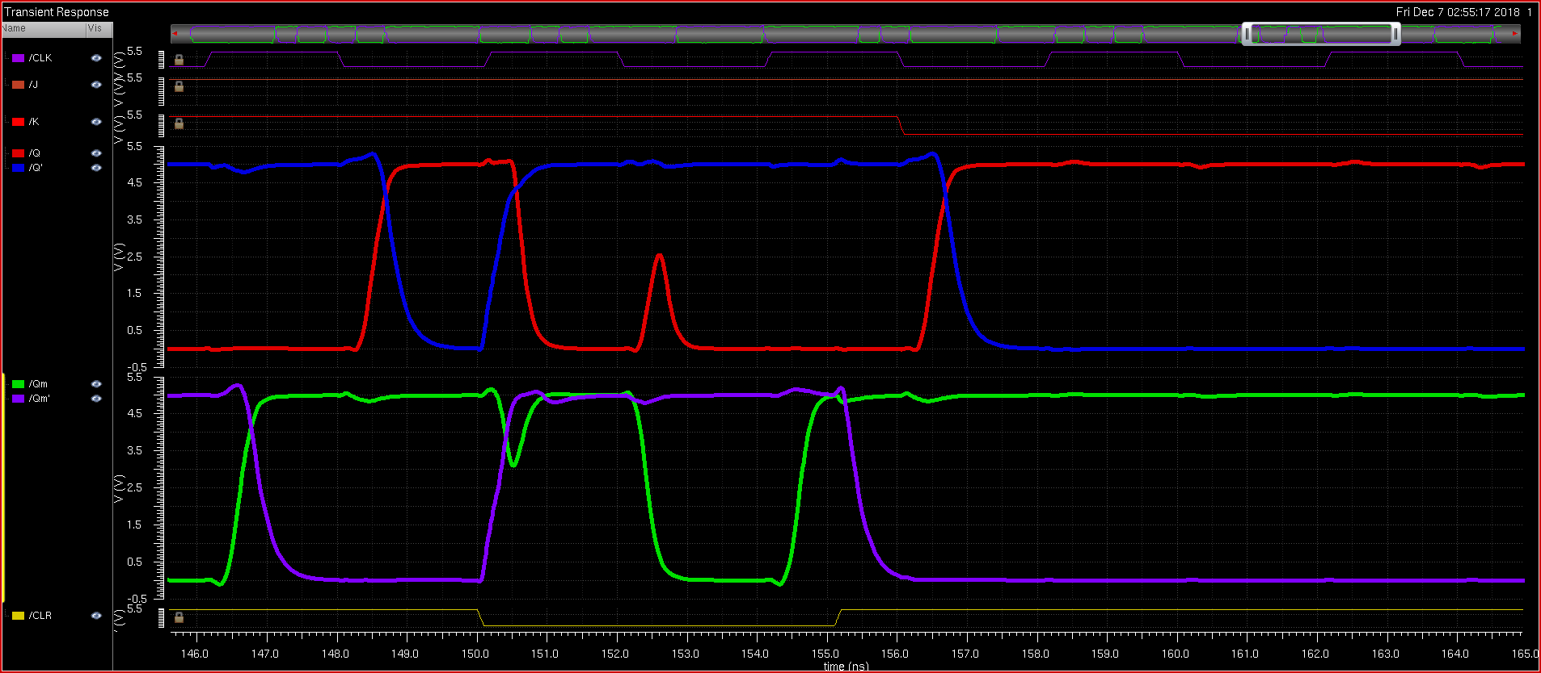
Standard Cell Library Simulation
Input / Output Waveforms

Slide 33
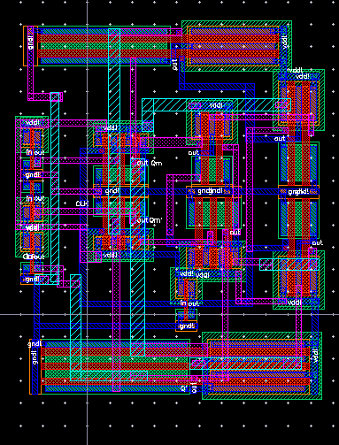
Snap-together Standard Cells
Circuit Layout

Slide 34
Snap-together Standard Cells Simulation
Input / Output Waveform
[INSERT WHEN CADENCE WORKS]

Slide 35
Delay Comparison
Logical Effort vs. Spectre
[Insert proper image when Cadence is back up]

Slide 36
Questions?

